Slide 1
Step-by-step demo of using
BioMart to extract SNP information
http://plants.ensembl.org/biomart/martview

Slide 2
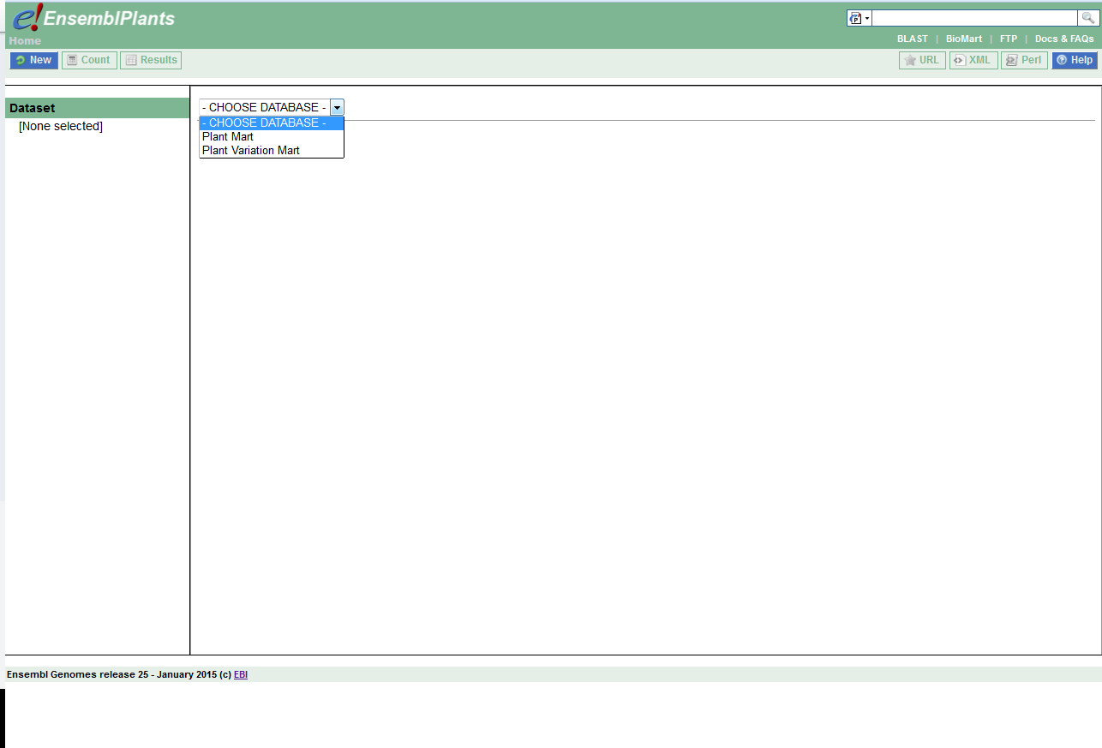

Slide 3
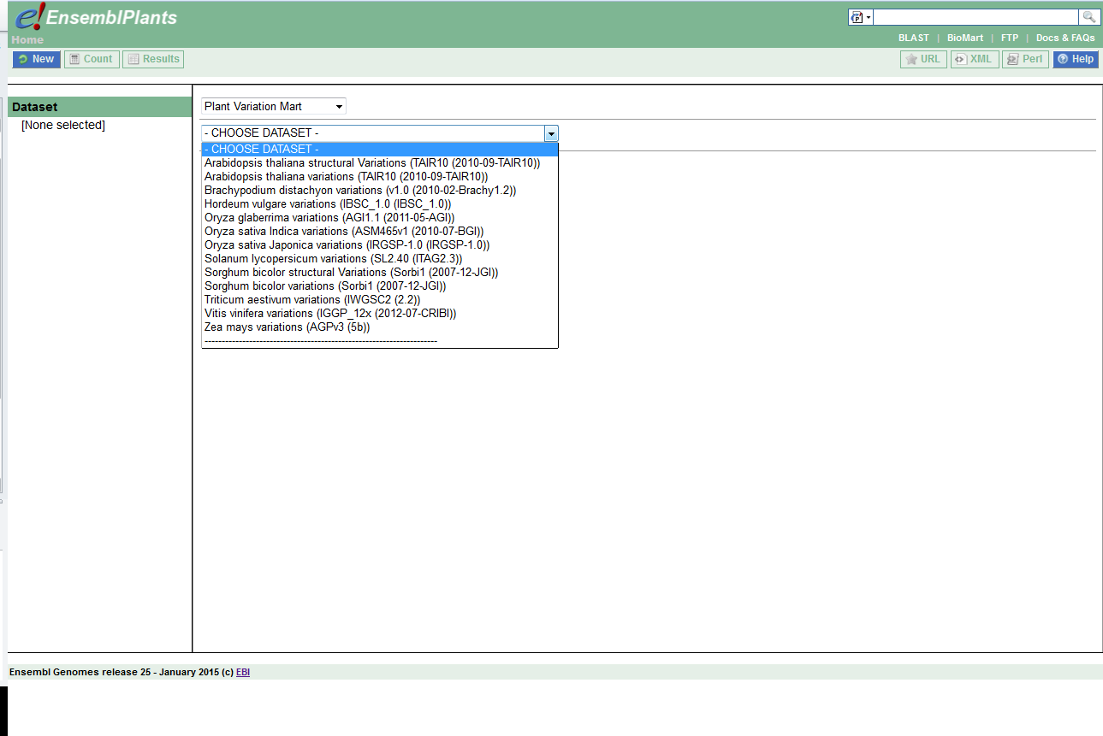

Slide 4
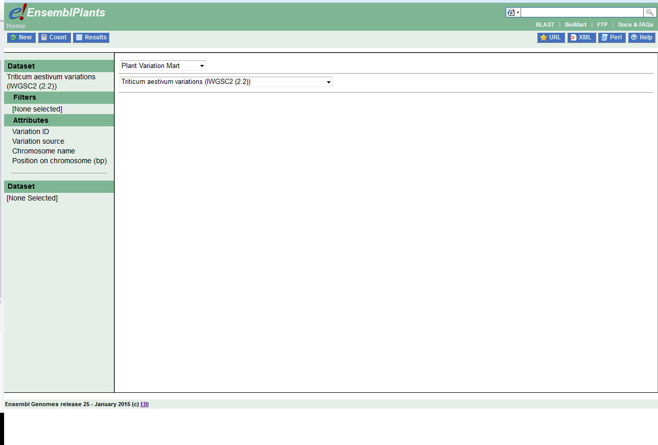
Selects particular data (e.g. chromosomal region)
Choose data to output (e.g. marker names)

Slide 5
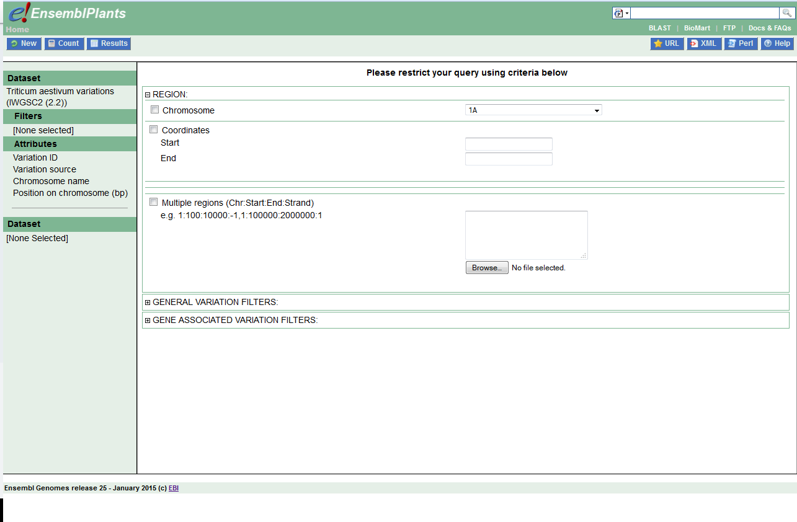

Slide 6
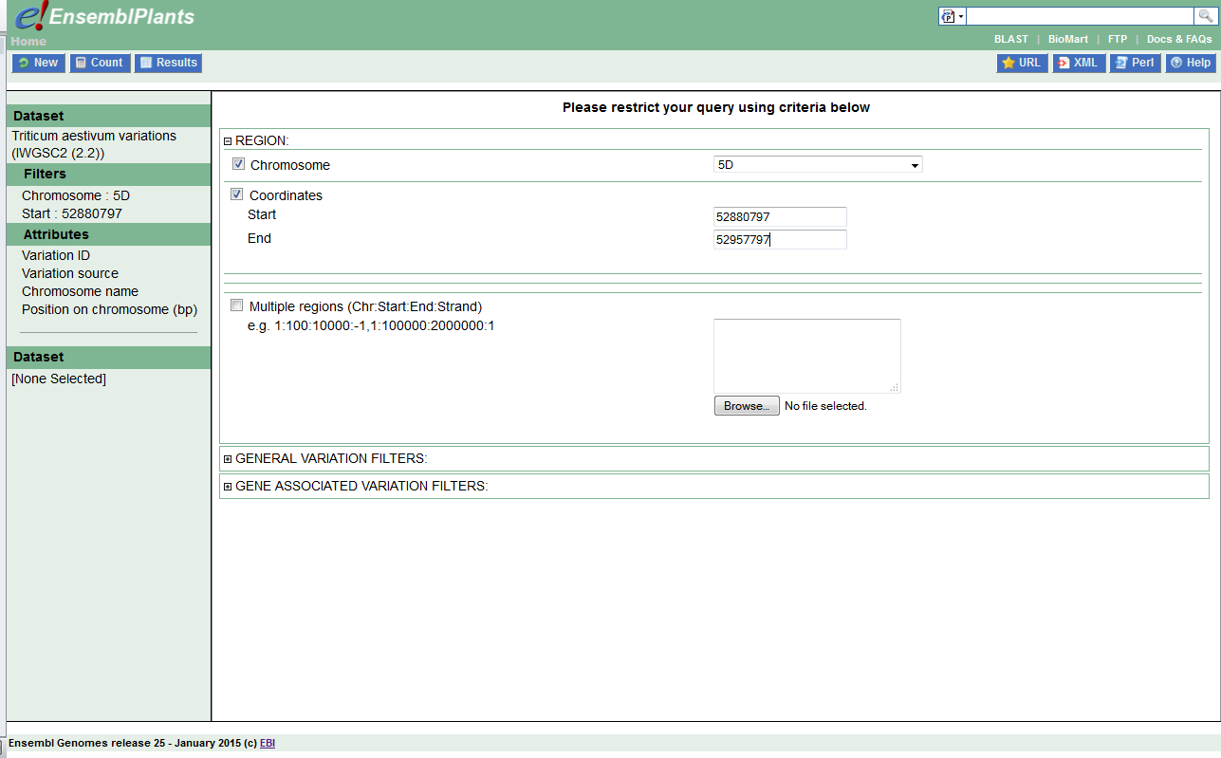

Slide 7
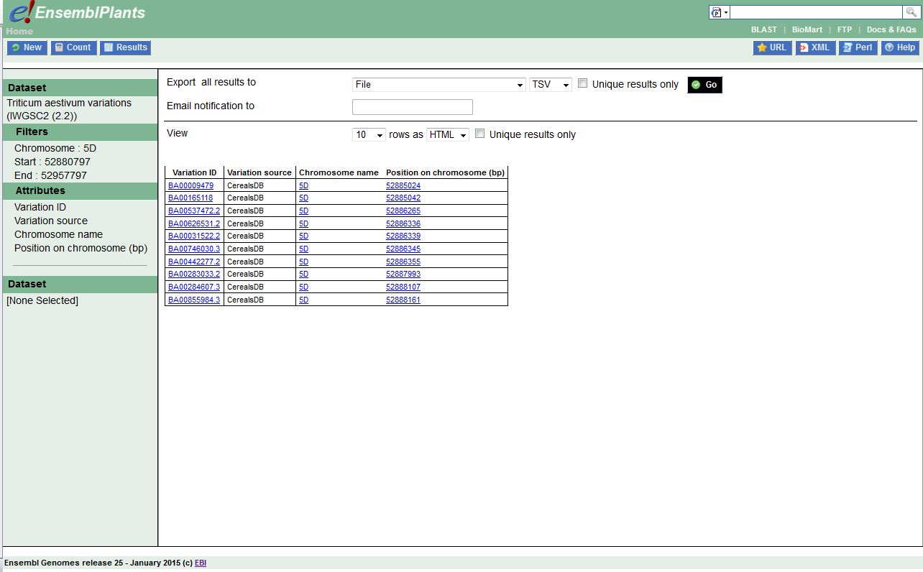

Slide 8

Choose data to output (e.g. variety/strain the SNP is found in)

Slide 9
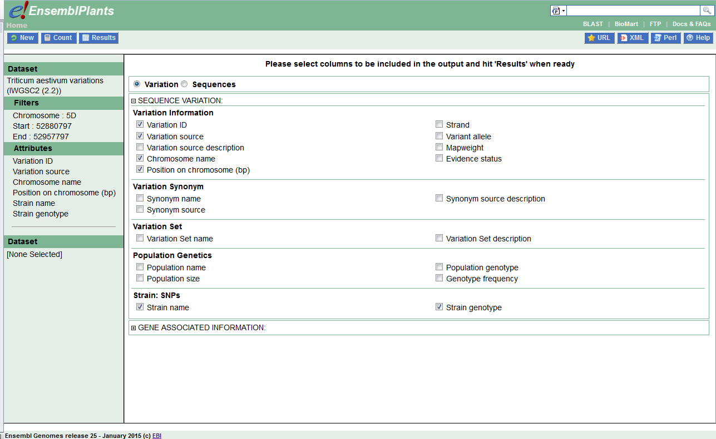

Slide 10
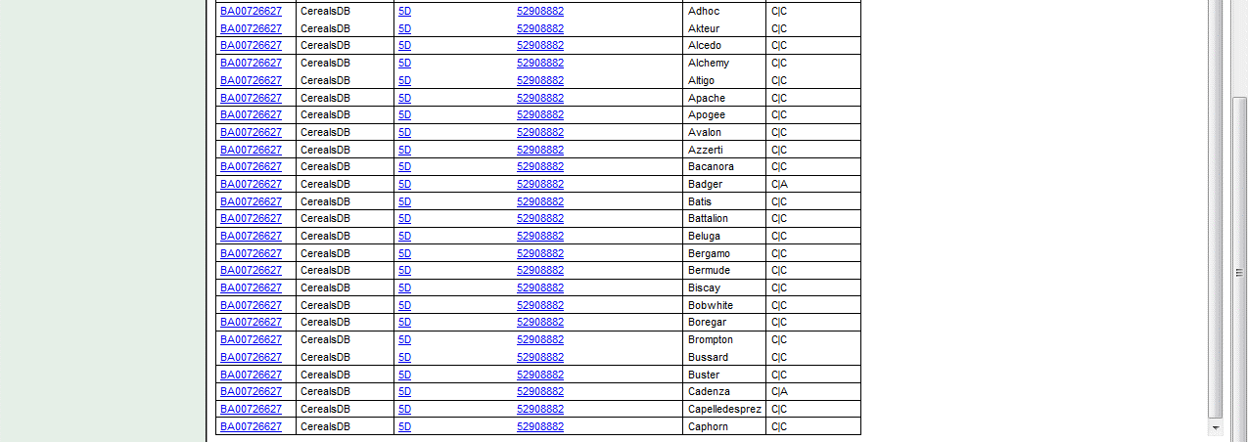

Slide 11
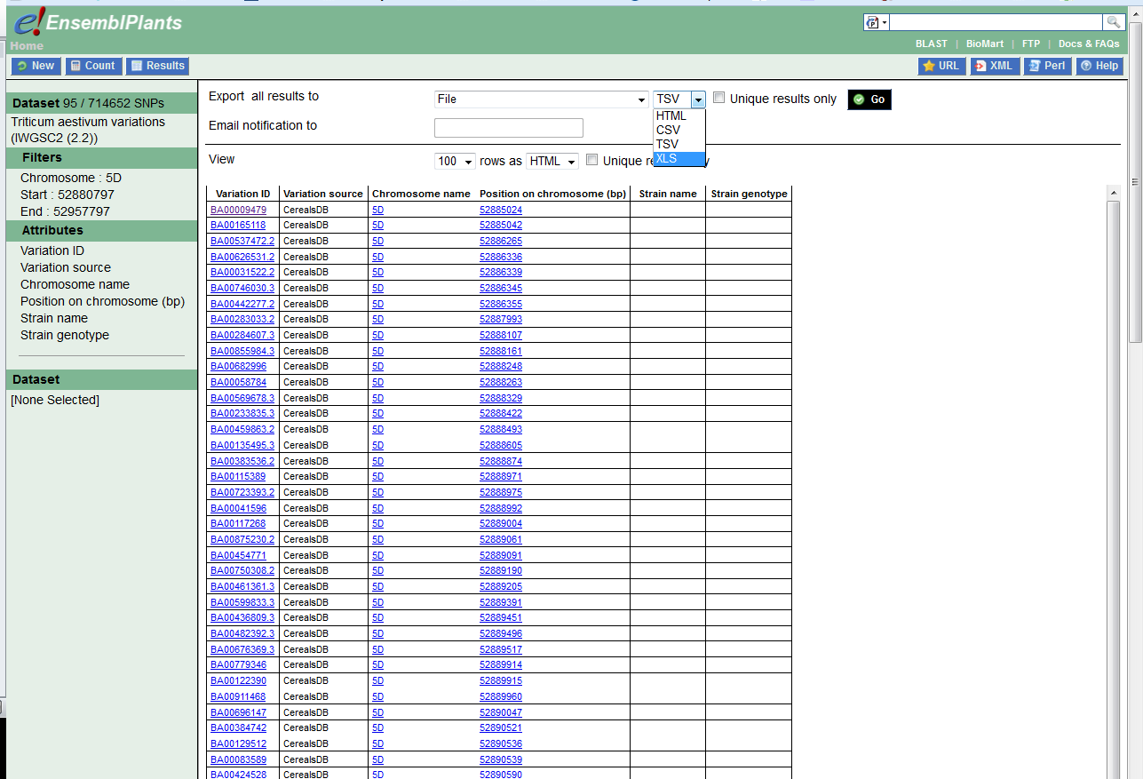

Slide 13
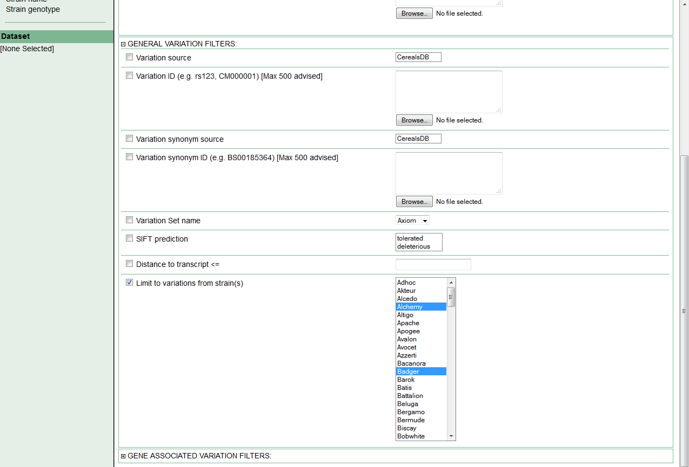
Click “results”

Slide 14
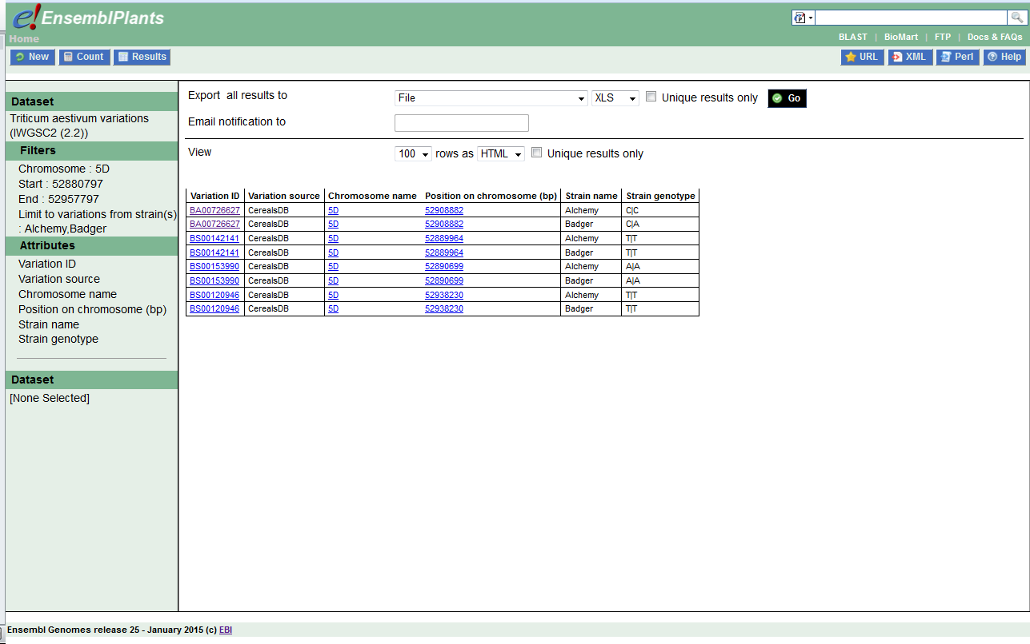

Slide 15
Summary of variation information
iSelect, Axiom and KASP and HapMap all available
Can see on browser and download on BioMart
Use “filters” to select chromosome regions and varieties (called strains on ensembl)
Use “attributes” to select types of data you want (i.e. columns)

Slide 16
How to go from SNP data in Ensembl to getting KASP markers?
Use PolyMarker!
http://polymarker.tgac.ac.uk/
For help see our step by step guide:
http://www.wheat-training.com/wp-content/uploads/Genomic_resources/How-to-use-Polymarker.pptx

