Slide 1
How to go from SNP data in Ensembl to getting KASP markers?
Welcome to PolyMarker!
http://polymarker.tgac.ac.uk/
Options:
Design your own primers
Download pre-designed primers for SNP data

Slide 2
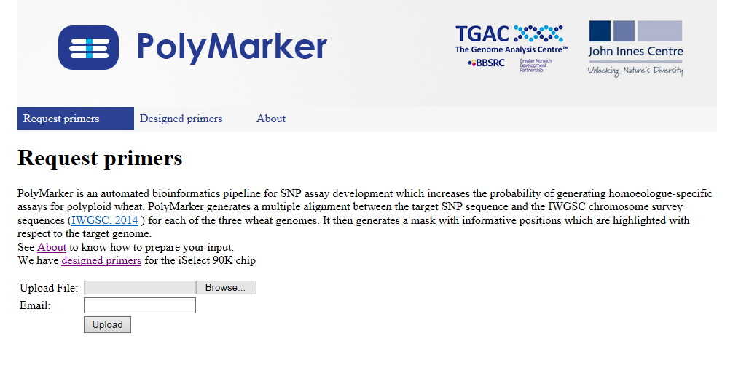
Option 1:
Design primers
Upload your .csv file
Enter your email address
Name/ID , Chromosome , Sequence [SNP/SNP] Sequence
Gene_1, 6B, ATGACGATACGGACGACA[A/T]ACGGGGGACGAGGG
Gene_1,6B,GATAAGCGATGACGATACGGACGACA[A/T]ACGGGGGACGAGGGATACGAT

Slide 3
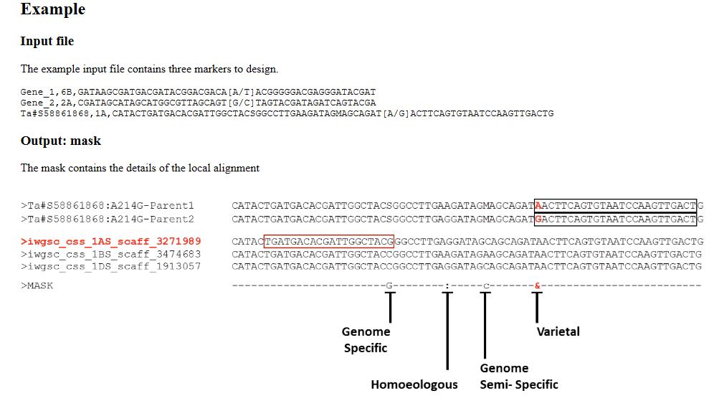
Create two separate input/parental sequences
Align to Chinese spring survey sequence (CSS)

Slide 4
Create a mask that summarizes the assembly

Slide 5
‘&’ means a SNP between the two parentals is varietal, i.e. non-homoeologous; the SNP can be used for a KASP marker

Slide 6
A colon means a SNP between the two parentals is homoeologous, i.e. not useful to distinguish genomes → SNP cannot be used for a KASP marker

Slide 7
A capital letter means a SNP between the two parentals is specific to one genome;
Here specific to 1AS

Slide 8
A lowercase letter means a SNP between the two parentals is semi-specific, i.e. shared by two genomes; here 1AS and 1DS

Slide 9
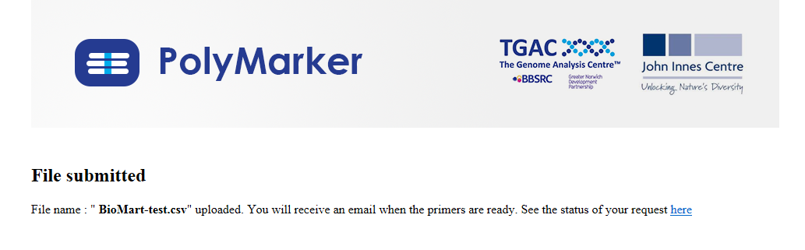
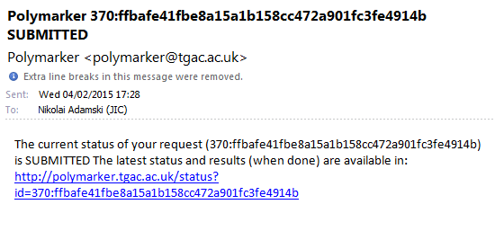
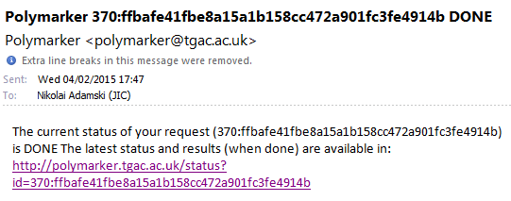
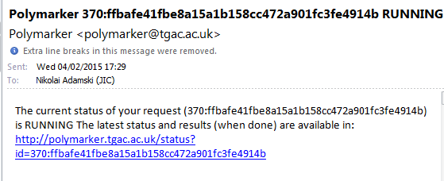

Slide 10
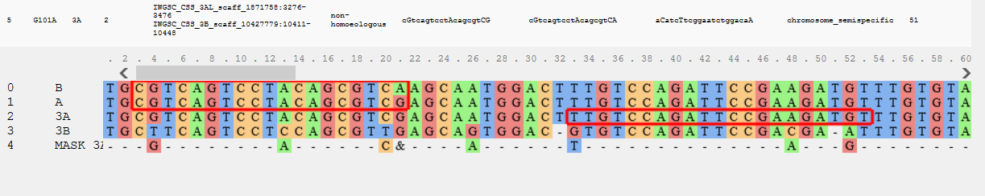
Non-homoeologous
Chromosome semi-specific
SNP is varietal
Genome specific SNP
Red Boxes around sequence denotes the boundaries of the designed primers

Slide 11
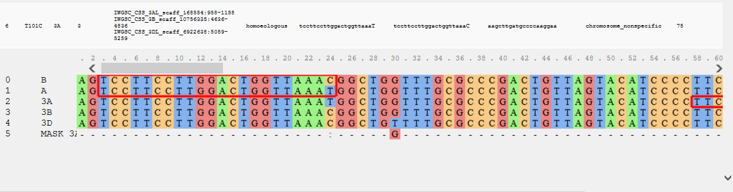
Homoeologous
Chromosome non-specific
SNP is homoeologous
No specificity

Slide 12
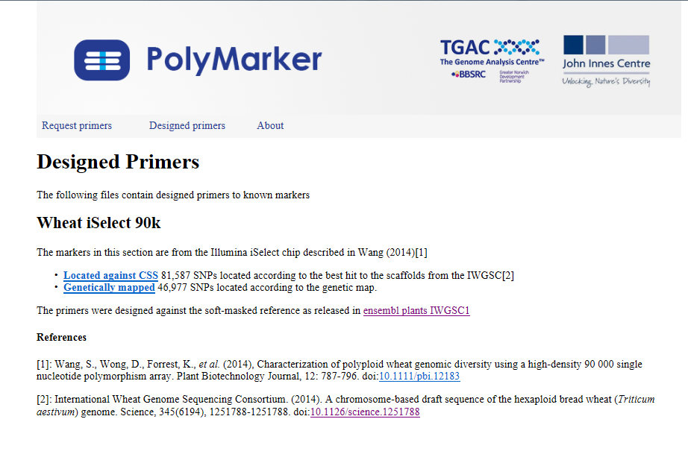
http://polymarker.tgac.ac.uk/Markdown?md=DesignedPrimers
Option 2:
Use previously designed markers

Slide 13
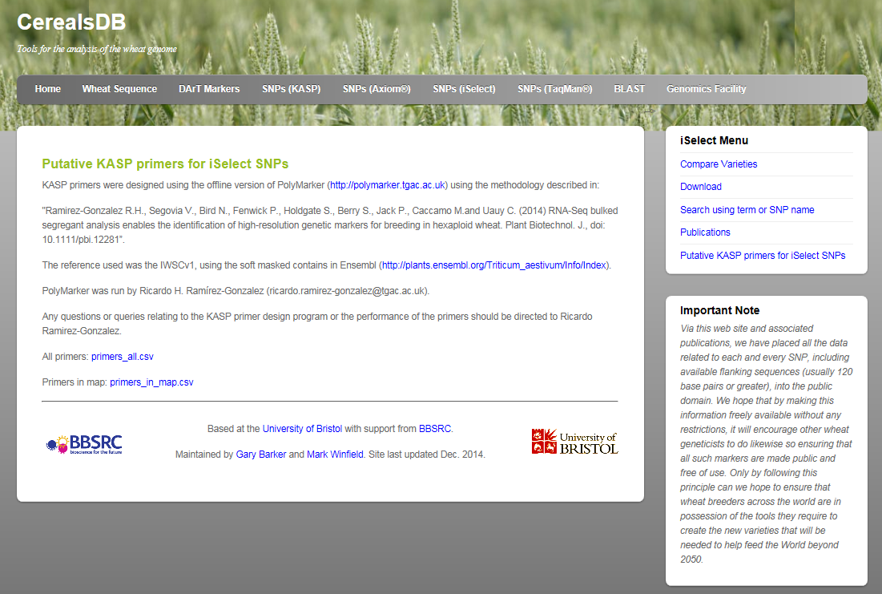
Or get them from CerealsDB
http://www.cerealsdb.uk.net/cerealgenomics/CerealsDB/KASP_primers_for_iSelect.php

